Slide 1

Hydro-economic Optimization:
A Primer and Case Studies
David Watkins
Dept. of Civil and Environmental Engineering
Michigan Technological University

Slide 2
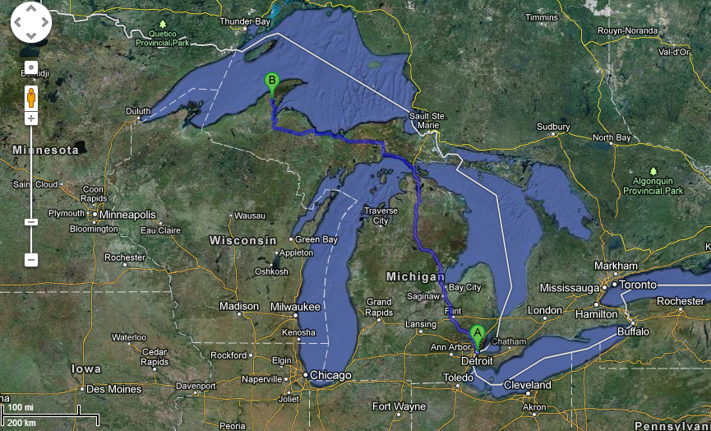
Where in the world?
Imagery ©2013 TerraMetrics, Map data ©2013 Google

Slide 3
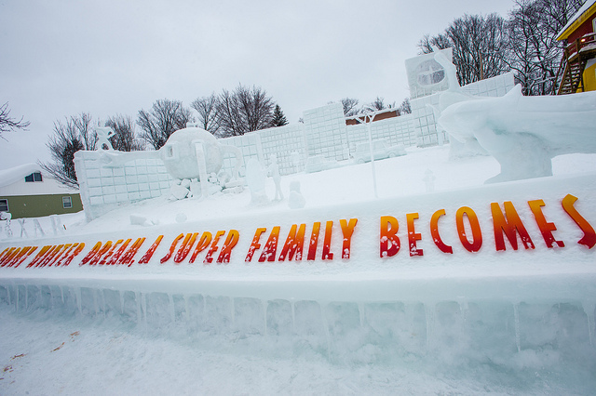
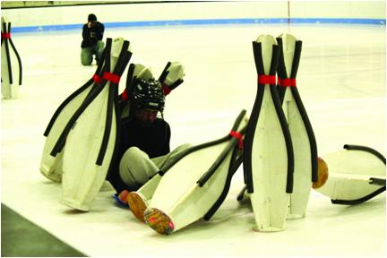

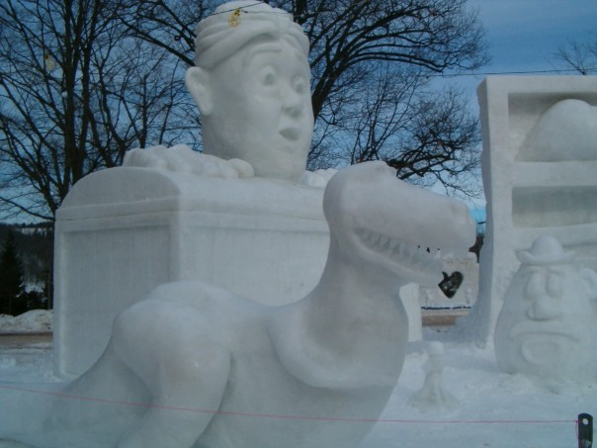

Winter Carnival

Slide 4
Outline
Optimization Primer
Case Studies
  Water Supply Planning for Central Texas
  South Florida Systems Analysis Model
  Climate Adaptation Planning for Amman, Jordan
Robust Decision Making (Lempert)
Proposed timeline for WSC tasks
  Inputs needed
  Stakeholder involvement

Slide 5
Optimization Primer:
Wyndor Glass Co. Example
The company has 3 factories that together produce both glass windows and doors.
Each factory specializes in certain components required for both products.
  Plant 1 makes aluminum frames.
  Plant 2 makes wood frames.
  Plant 3 makes glass and assembles window and door products.
The company sells 2 products:
  Glass doors with aluminum frames
  Wood-framed glass windows

Slide 6
Wyndor Glass Co.
Each plant has a limited capacity.
Each product is sold for a fixed price with a fixed profit per unit.
Data: Plant | Production Time (hrs) Doors Windows |  | Capacity Available (hours)
1 | 1 | 0 | 4
2 | 0 | 2 | 12
3 | 3 | 2 | 18
Unit Profit | $3 | $5 | -

Slide 7
Wyndor Glass Co.
Mathematically:
  X1 = Number of doors produced
  X2 = Number of windows produced

Slide 8
Wyndor Glass Co.
A graphical solution:
  Graph the constraint set and feasible region.
  Plot contour lines of the objective function.
  Move out towards higher obj. fn. values until solution is no longer feasible.
  Z > 36 is not feasible.
Feasible

Slide 9
Wyndor Glass Co.
A graphical solution:
  Graph the constraint set and feasible region.
  Plot contour lines of the objective function.
  Move out towards higher obj. fn. values until solution is no longer feasible.
  Z > 36 is not feasible.
Feasible

Slide 10
Wyndor Glass Co.
A graphical solution:
  Graph the constraint set and feasible region.
  Plot contour lines of the objective function.
  Move out towards higher obj. fn. values until solution is no longer feasible.
  Z > 36 is not feasible.
Feasible

Slide 11
Wyndor Glass Co.
A graphical solution:
  Graph the constraint set and feasible region.
  Plot contour lines of the objective function.
  Move out towards higher obj. fn. values until solution is no longer feasible.
  Z > 36 is not feasible.
Feasible

Slide 12
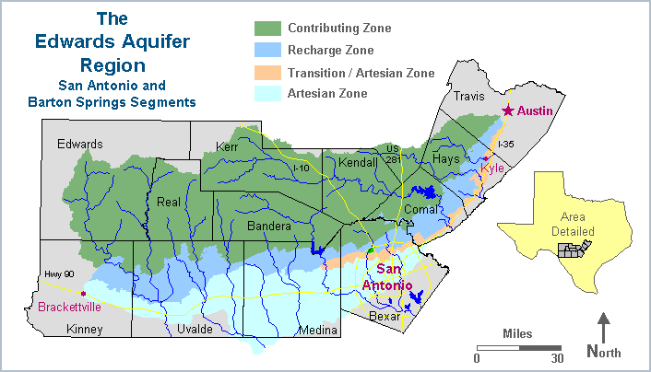
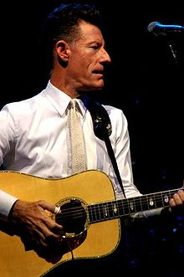
Now for a more complex problem
(Eckhardt, 1997)
Watkins, D.W. Jr., and D.C. McKinney, “Screening Water Supply Options for the Edwards Aquifer Region in Central Texas,” Journal of Water Resources Planning and Management, ASCE, 125(1): 14-24, 1999.

Slide 13
Central Texas Water System Network

Slide 14
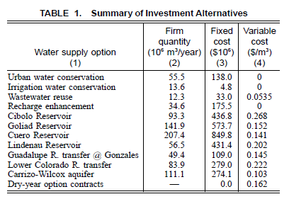
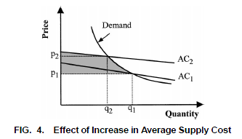
Infrastructure, Management, and Policy Alternatives
Watkins, D.W. Jr., and D.C. McKinney, “Screening Water Supply Options for the Edwards Aquifer Region in Central Texas,” Journal of Water Resources Planning and Management, ASCE, 125(1): 14-24, 1999.

Slide 15
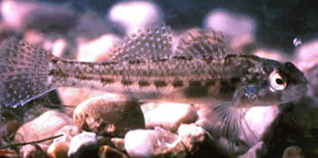
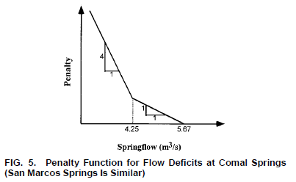
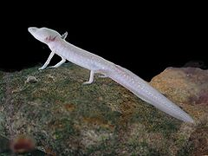
Springflow Deficit Penalties
(Watkins and McKinney, 1999).
Wikipedia Commons

Slide 16
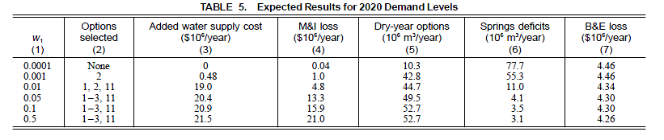
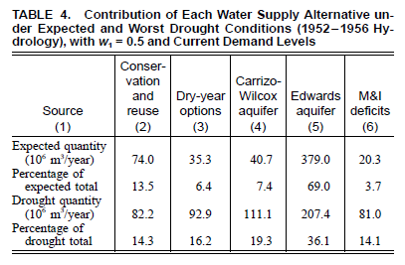
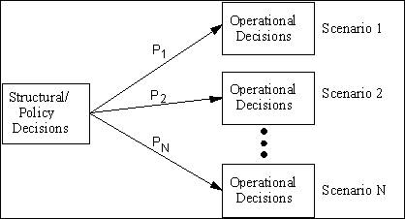
Model Results
Watkins, D.W. Jr., and D.C. McKinney, “Screening Water Supply Options for the Edwards Aquifer Region in Central Texas,” Journal of Water Resources Planning and Management, ASCE, 125(1): 14-24, 1999.

Slide 17
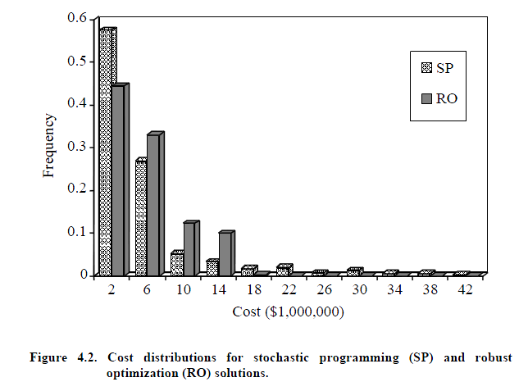
“Robust” Optimization
Watkins, D.W. Jr., and D.C. McKinney, “Finding Robust
Solutions to Water Resources Problems,” Journal of Water
Resources Planning and Management, ASCE, 123(1):
49-58, 1997.

Slide 18
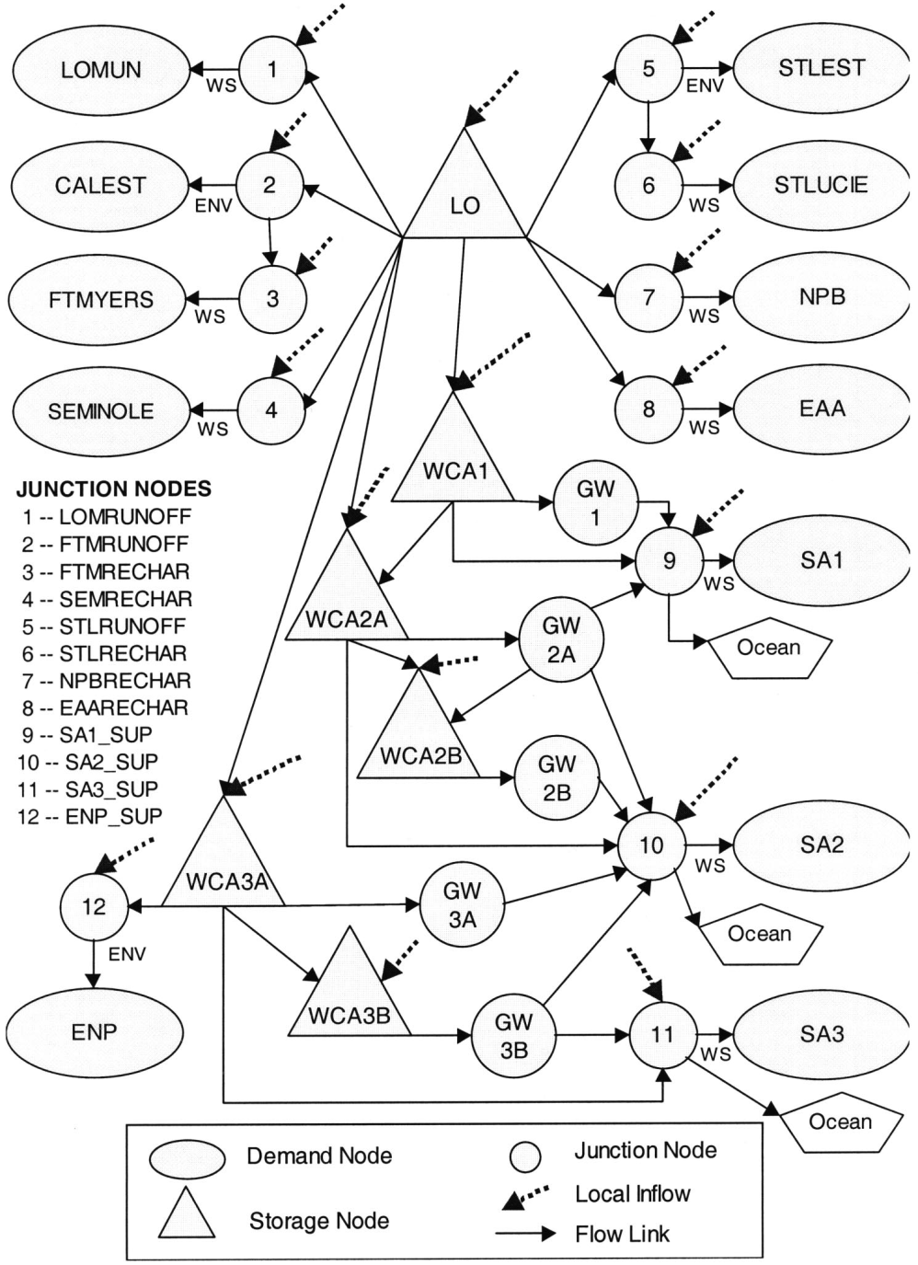
South Florida Systems Analysis Model (SFSAM)
Project by USACE as part of Central & South Florida Project “Restudy”, with support of SFWMD
“Screening” model to evaluate potential benefits of new storage areas
Simple network structure allowed long time series of operations to be “optimized”
Used simple penalty functions with objective of minimizing total penalties for deviations from target levels and flows.
(Watkins, et al., 2004)

Slide 19
SFSAM Input Data
Unregulated inflows
  Used monthly time series, 1965-1989.
Flow capacities and targets (by month)
Storage limits and targets (by month)
Reservoir storage-surface area relationships
Seepage estimates (from SFRRM)

Slide 20
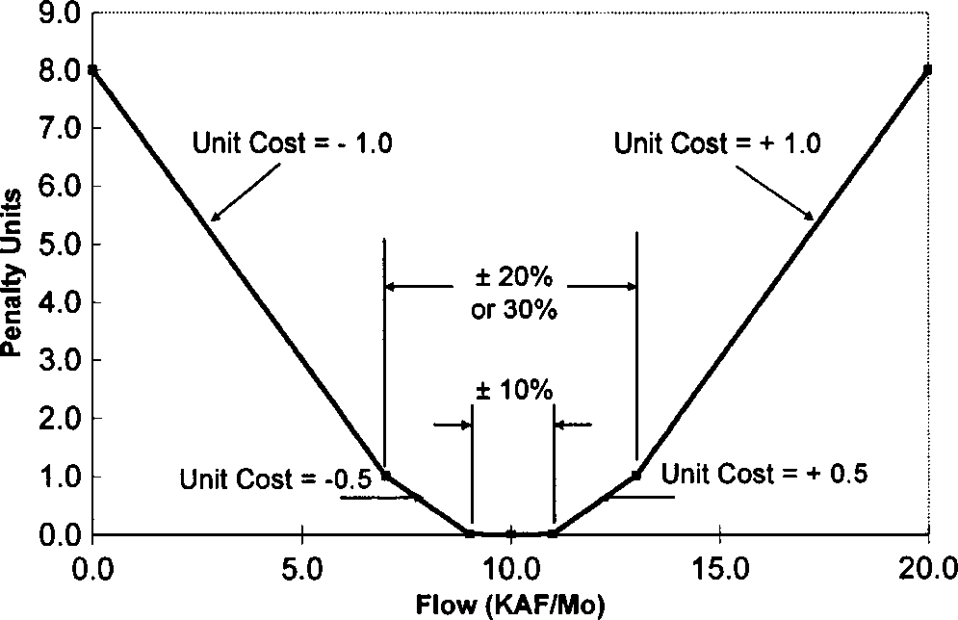
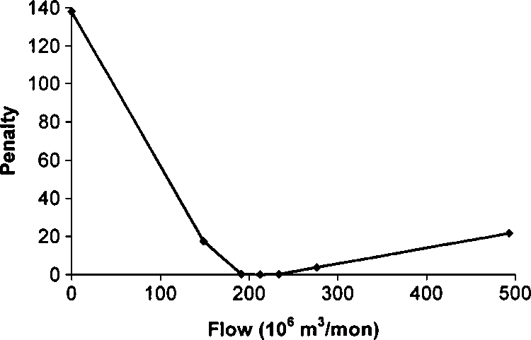
Example Penalty Functions
Water Supply
Everglades N.P.
(Watkins, et al., 2004)

Slide 21
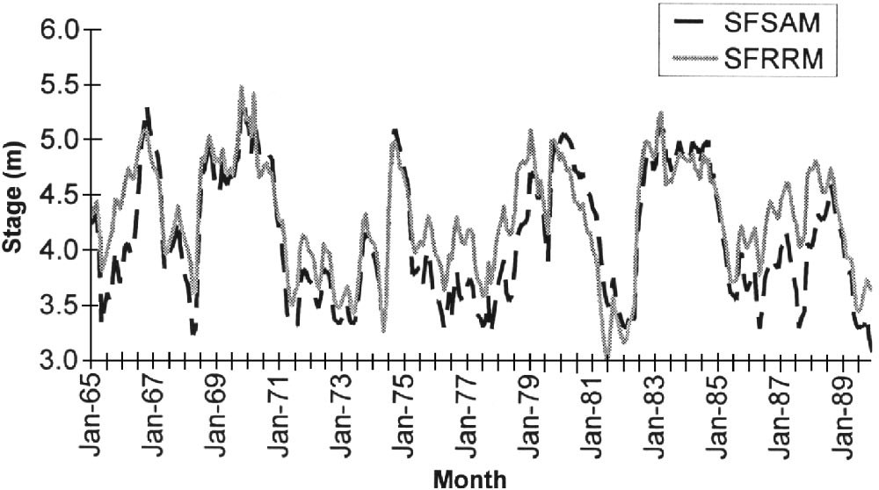
Model Validation
Lake Okeechobee
“Foresight”
“End
effects”
(Watkins, et al., 2004)

Slide 22
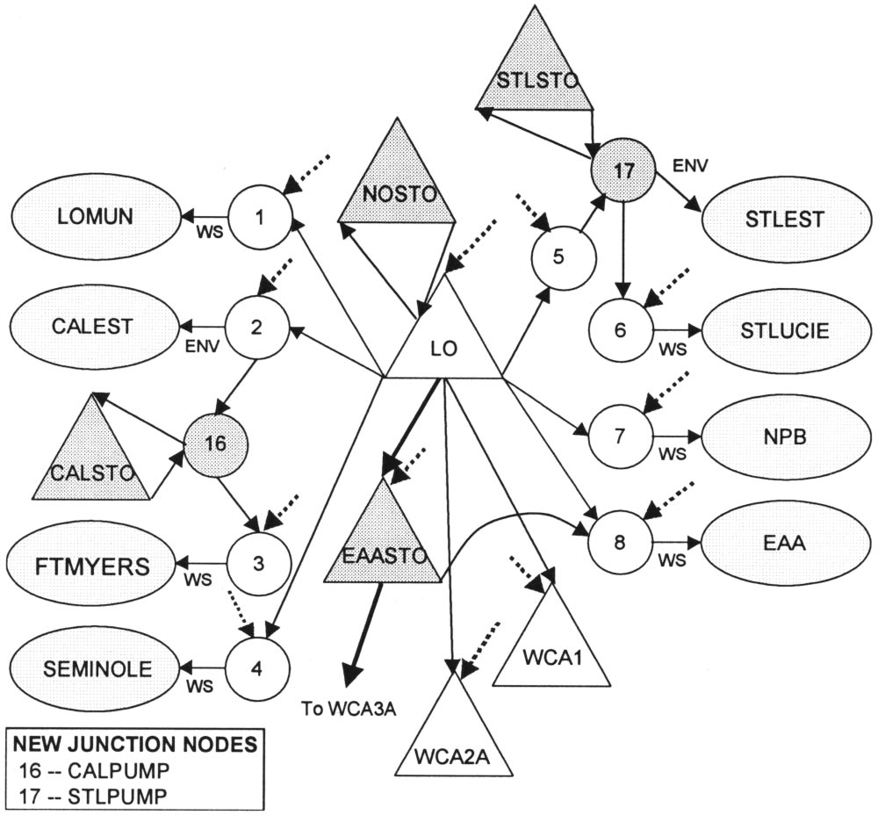
Proposed Storage Areas
(Watkins, et al., 2004)

Slide 23
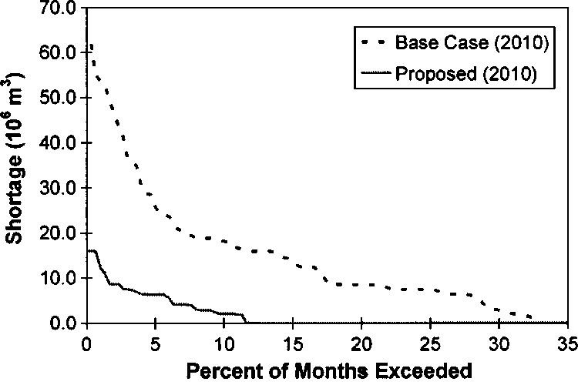
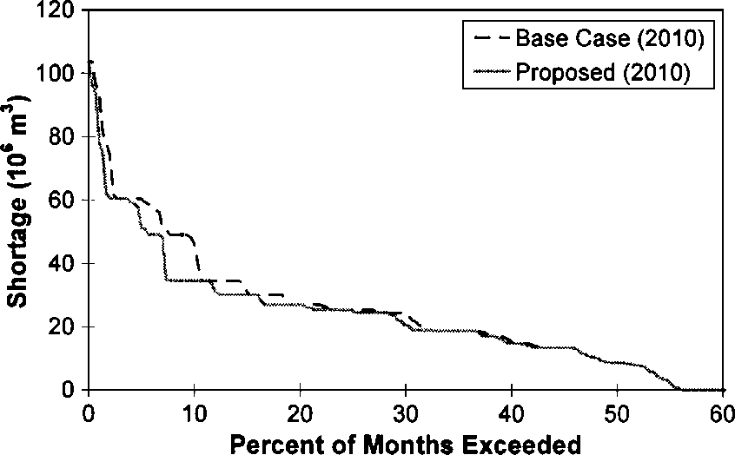
Some Results
Ft. Meyers Service Area
Everglades N.P.
(Watkins, et al., 2004)

Slide 24
SFSAM Limitations
Simple network model structure
Deterministic optimization
  i.e., “perfect foresight”
No economics
  Nor ecosystem service valuation!
Considered a limited set of ecological goals
Limited trade-off analysis
Notes:
Expect that in this project we will overcome / minimize each of these limitations.

Slide 25
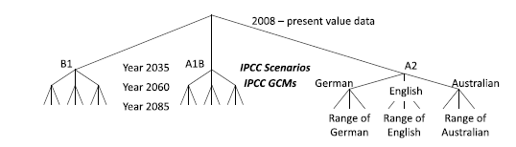
Water Supply Planning in Amman, Jordan
Considered staged infrastructure development under climate scenarios
Represents adaptation planning
Ray, P.A., P.K. Kirshen, and D.W. Watkins Jr., “Stochastic
Programming for Staged Climate Change Adaptation Planning
for Amman, Jordan,” Journal of Water Resources Planning and
Management, doi: 10.1061/(ASCE)WR.1943-5452.0000172, 2012.

Slide 26
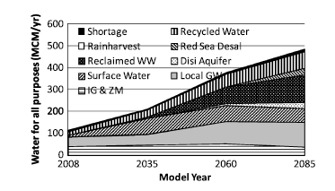
Model Results
(Ray, et al., 2012)

Slide 27
WSC Goals / Objectives
Apply robust decision-making (RDM) approach (Lempert and Groves 2010).
Approach based on robust optimization, incorporating aspects of “decision-scaling” (Brown, 2011):
  Generate candidate water management strategies using a baseline (e.g., historical) scenario.
  Assess vulnerability of these strategies to climate change, land use and SLR scenarios.
  Evaluate costs associated with re-allocation or infrastructure investments needed to hedge against these vulnerabilities.

Slide 28
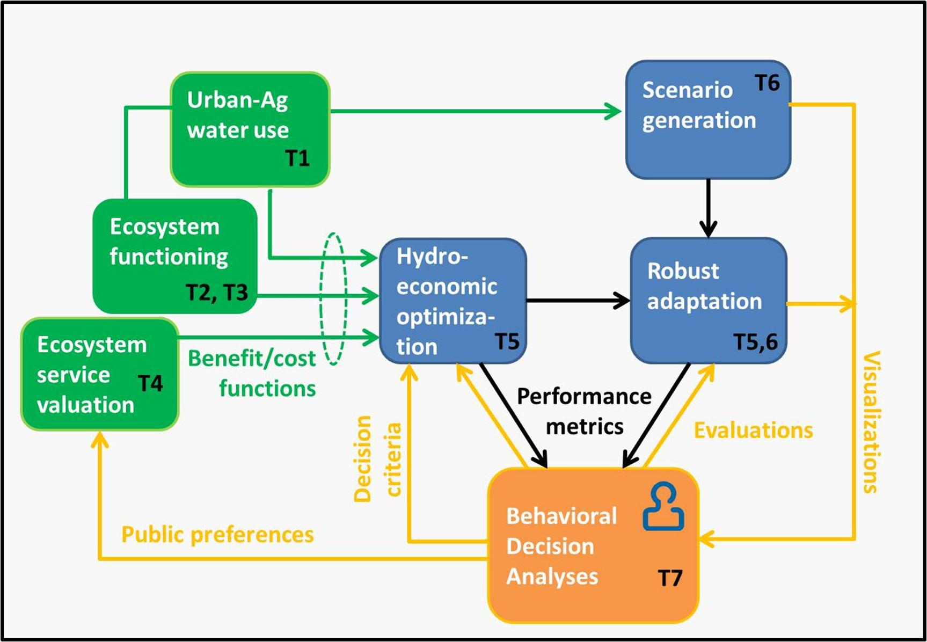
WSC Project Flowchart

Slide 29
WSC Tasks / Timeline
Year 1:
Development and testing of prototype deterministic hydro-economic optimization model
  Based on existing infrastructure, historical hydrologic data, and preliminary ecological and economic objective functions.
Application of the deterministic model to individual (preliminary) hydrologic scenarios.
Year 2:
Extension to two-stage and four-stage stochastic models.
Identification of climate predictability and long-term investment alternatives.
Refinement of ecological and economic objective functions.
Notes:
Need hydrologic input data (e.g., unregulated inflows, lake evaporation rates) and penalty functions (e.g., target flows to prevent saltwater intrusion).
The model will be exercised deterministically to provide “best possible” results for each case. The benefits of the deterministic solution are two-fold:
The best-possible result for each scenario can be used to compute regret, a criterion often used in decision-making under uncertainty, and
(ii) Ranking of best-possible outcomes provides insights to challenging scenarios and system vulnerabilities, as well as scenarios that are not taxing and may either be dropped or merged together in the stochastic analysis. Results will be presented in terms of benefits (WTP), costs (penalties), and net benefit estimations.

Slide 30
WSC Tasks / Timeline
Year 3:
Application of the two-stage (operational) stochastic model to evaluate the potential of seasonal forecasts.
Preliminary application of the four-stage (planning model) to evaluate long-term investments.
Year 4:
Refinement and application of stochastic models for trade-off analysis, uncertainty assessment, conflict resolution, and adaptive management planning.
Notes:
3) Two-stage model exercised using a rolling time horizon, producing outputs at each time step. Provides insights to operation plans that are robust with respect to climate variability and projected climate changes.
4) Gain insights to value of keeping options open and “safety valve” strategies.

Slide 31
Stakeholder / Decision Maker Interaction
For computational tractability, may only consider a small number of discrete infrastructure decisions in the four-stage model
Infrastructure alternatives can also be tested using an iterative approach, with both stakeholder input and the “shadow prices” (dual costs) on capacity constraints in the model guiding the selection process.
Outputs from robust optimization will include uncertainty ranges for future outcomes, given alternatives selected today and adaptable decisions made in future stages.
Within the framework of robust decision making, the model may be formulated with different decision criteria, allowing the evaluation of which criteria decision makers prefer and why.
For the purpose of conflict resolution, robust optimization provides a convenient means of exploring Pareto-optimal solutions that may potentially constitute “win-win,” or at least promising alternatives.

Slide 32
References
Lempert, R. J., and D.G. Groves, "Identifying and Evaluating Robust Adaptive Policy Responses to Climate Change for Water Management Agencies in the American West." Technological Forecasting and Social Change, 2010.
Ray, P.A., P.K. Kirshen, and D.W. Watkins Jr., “Stochastic Programming for Staged Climate Change Adaptation Planning for Amman, Jordan,” Journal of Water Resources Planning and Management, doi: 10.1061/(ASCE)WR.1943-5452.0000172, 2012.
Watkins, D.W. Jr., and D.C. McKinney, “Finding Robust Solutions to Water Resources Problems,” Journal of Water Resources Planning and Management, ASCE, 123(1): 49-58, 1997.
Watkins, D.W. Jr., and D.C. McKinney, “Screening Water Supply Options for the Edwards Aquifer Region in Central Texas,” Journal of Water Resources Planning and Management, ASCE, 125(1): 14-24, 1999.
Watkins, D.W. Jr., K.W. Kirby, and R.E. Punnett, “Water for the Everglades: The South Florida Systems Analysis Model,” Journal of Water Resources Planning and Management, ASCE, 130(5): 359-366, 2004.

